Slide 1
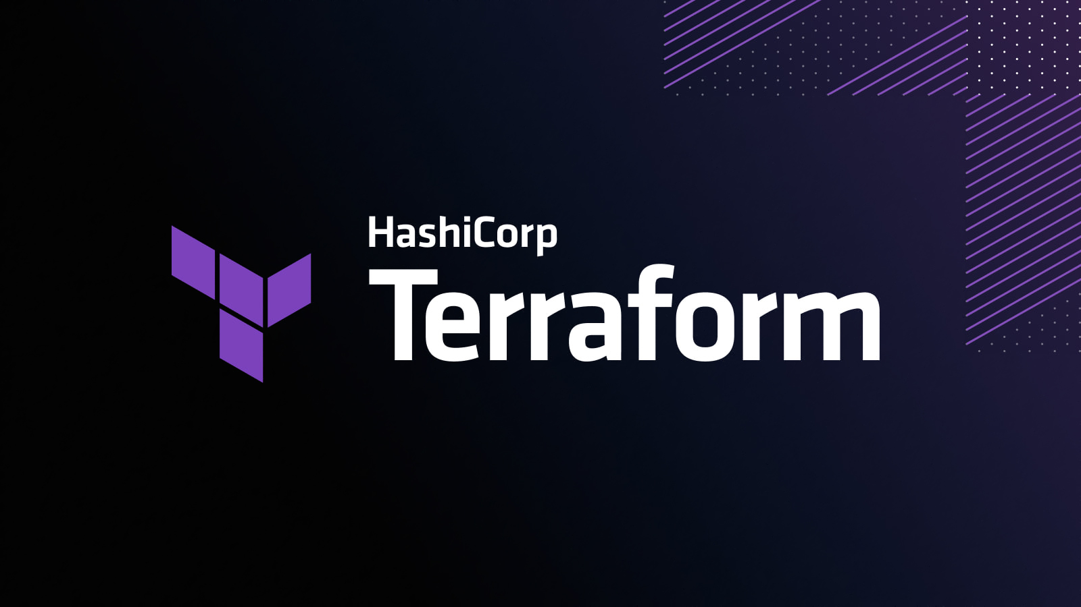
Infrastructure as Code with Terraform
Besart Sulejmani
Notes:
Welcome to this presentation/workshop for Infrastructure as Code with Terraform. My name is Besart Sulejmani, I’m a devops engineer that focusses on CI/CD, Infrastructure-as-Code, Configuration-as-Code, containerization etc. All things that have to do with automation actually.
This workshop is designed for people that want to get a basic understanding of Terraform but also somewhat general information on Infrastructure-as-Code.
There are demos and configurations you can work with to give you the Terraform knowledge you need, so you can start working with Terraform in a development/production environment.

Slide 2

Content
What is Infrastructure as Code (IaC) in general?
Introduction to Terraform
Providers
Terraform commands
Statefile
Variables & Outputs
Dependencies
Data sources
Modules
Remote backend
Terraform & Azure DevOps
Notes:
Go over this slide deck and check the notes in each slide for information.
In the demo slides you’ll find instructions, or you can also read the markdown files in each of the configuration sections in the “Terraform” folder on GitHub.

Slide 3

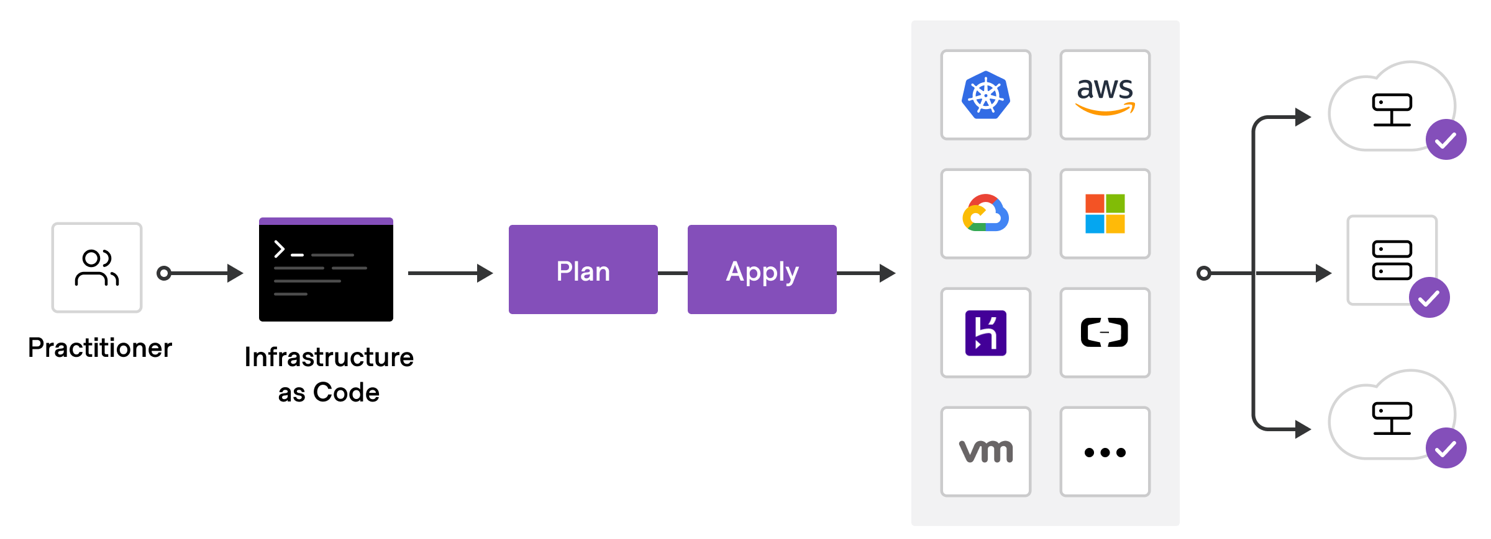
What is Infrastructure as Code?
Traditional way of provisioning
Provision infrastructure with code rather than interactive configuration tools
Notes:
Let’s talk about the past first on traditional software delivery and what kind of pattern it would follow:
A System Administrator would setup up a physical server and install the operating system, patch the machine and install all the necessary software to run an application.
Then an Application Administrator installs application software and configures it. Or he configures a database server.
You would do these operations manually and do this for all your environments (Dev, Test, Acceptance and Production).
The developer would deliver the code by copying it to the server
Once the new code had gone through the entire process of verifying it, testing it etc. you can deploy it in production you would think. Do you think this worked 100% of the time? A lot of manual processes and manual interactions can cause human errors!
With infrastructure as code, you capture your environment (or multiple environments) in a configuration file (script or definition).
You can check in the code into version control and then use it as the source for updating existing environments or creating new ones.
Infrastructure as Code is the process of provisioning infrastructure resources through code rather than physically configuring hardware or provisioning through interactive configuration tools.

Slide 4
Benefits of IaC
Manual Deployment | Infrastructure as code
Snowflake servers | Consistent server(s) between environments
Deployment steps vary by environment | Environments are created or scaled easily
More verification steps and more elaborate manual processes | Fully automated creation of environment(s) and updates
Increased documentation to account for differences | Transition to immutable infrastructure
Deployment on weekends to allow time to recover from errors. | Use blue/green deployments.
Slower release cadence to minimize pain and long weekends. | Treat servers as cattle, not pets.
Table source: Microsoft AZ-400 DevOps Engineer Expert skillpipe book
Notes:
The following table lists the significant differences between manual deployment and Infrastructure as code.
Infrastructure as code:
Provides consistent environments from release to release
Greater consistency across DTAP environments
Promotes auditing by making it easier to trace what was deployed (improves traceability)
Treats infrastructure as a flexible resource that can be provisioned, de-provisioned, and reprovisioned as and when needed.
Meaning of “treating servers as cattle, not pets”:
Servers as pets are treated indispensible or unique systems that can never be down. Typically, manually built and managed.
Servers as cattle are designed for failure, where no servers on the chain are irreplacable. Just about anything that is load balanced and multi primary. Often built using automated tools.
Blue/green deployments enable you to launch a new version (green) of your application alongside the old version (blue) and monitor and test the new version before you reroute traffic to it. On issues detection you would then roll back to the previous version.

Slide 5
Introduction to Terraform
Open-source IaC tool
Created by HashiCorp
Hashicorp Configuration Language
Declarative config language
Designed to allow JSON as an input
Cloud agnostic
Multi vendor (219 official/verified providers)
Terraform performs CRUD to accomplish the desired state
Notes:
Open-source infrastructure as code tool created by HashiCorp that allows you to provision, manage, and version cloud infrastructure. It codifies infrastructure in configuration files that describe the topology of cloud resources such as VMs, storage accounts, and networking interfaces.
Terraforms CLI allows you to run individual commands interactively and provides a simple mechanism to deploy and version configuration files to Azure or any other supported cloud service
It can be used non-interactively as well as part of a CI/CD pipeline
It’s a declarative configuration language which HashiCorp calls HCL. Rather than using imperative commands to provision resources, Terraform uses declarative configuration to describe the desired final state.
Imperative means “tell me exactly how to do it step by step”
Declarative means “tell me what you need, and I’ll know how to do it for you”
Cloud agnostic which means it can be used on any cloud service AWS, Azure, Google Cloud
Terraform supports a lot of vendors. 219 of around 18000 are verified providers.
Performs Create, Read, Update, Delete actions on the users behalf to accomplish the desired state

Slide 6

SETUP
Install Terraform: https://www.terraform.io/downloads
Visual Studio Code : https://code.visualstudio.com/
VS Code extensions:
Hashicorp Terraform
Azure account extension
Git (version control): https://git-scm.com/downloads
Azure subscription: https://azure.microsoft.com/en-us/free/
Notes:
Install Terraform to use the CLI on your machine
An Azure subscription where you can deploy Azure resources to
Before moving on with these slides, you may install Visual Studio Code because we’re going through a few demos. VS Code is a nice code editor that we can use for this workshop. Some extensions in VS Code that come in handy can be installed as well:
HashiCorp Terraform to help you with syntax checking and intelli-sense
The Azure Account extensions to easily connect to your Azure subscription from within VS Code
Git version control is used for the last demo when pushing the code to Azure DevOps.

Slide 7
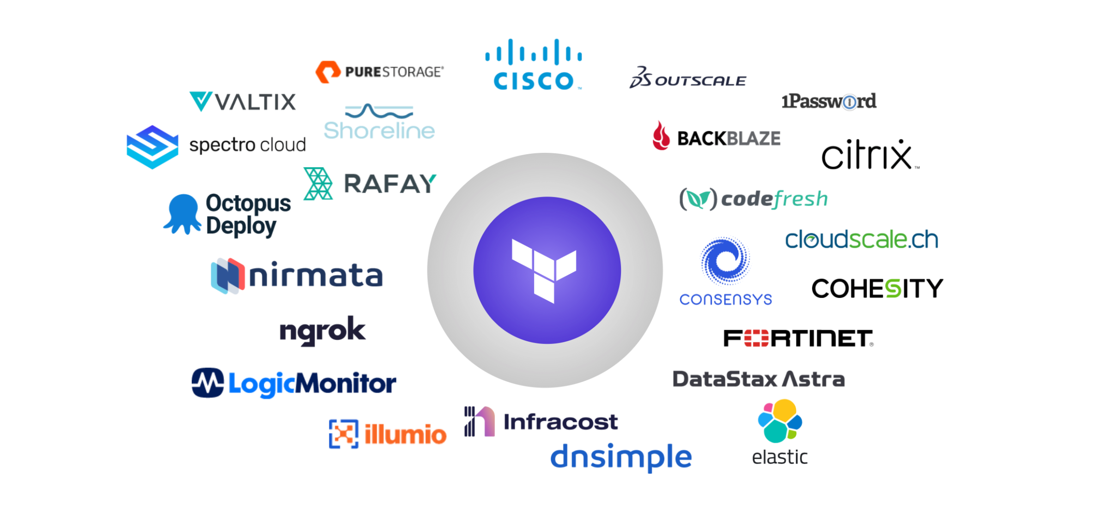
Providers
Plugins to interact with API’s
Required!
Provide resource types and data sources
Notes:
Terraform relies on plugins called "providers" to interact with cloud providers, SaaS providers, and other APIs.
Terraform configurations must declare which providers they require so that Terraform can install and use them.
Each provider adds a set of resource types and/or data sources that Terraform can manage so they’re mandatory in your configuration.

Slide 8
DEMO First- Resource
Notes:
First-Resource demo
Create a folder called “Terraform”
Create a sub folder called “first-resource”
Create a “main.tf” file
Start off with the terraform block and add the required providers block, in this case azurerm
Specify the source and version
Add the providers block for azurerm with the features block and leave it empty
Add a resource block
Resource is telling terraform that we want to create something
The Type tells terraform the actual resource that you want to create
Name isn’t what we want to call the resource but rather internally inside our Terraform code how we can refer to it
Add virtual network resource with the attributes as is in the source code

Slide 9
Recap first-resource demo
Created main.tf
Added azurerm provider
Declared first-resource
Notes:
You created a terraform configuration file and added the azurerm provider. Based on the provider, terraform knows which types of resources to create for you.
We have declared a resource group and virtual network in our main.tf
Proceed to the next slide to learn about terraform commands.

Slide 10
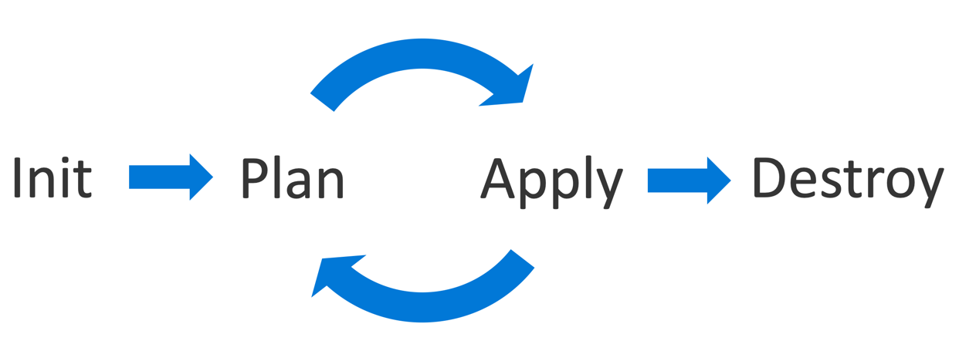
Terraform commands
Initialize directory
Plan changes
Apply changes
Destroy resources
Notes:
The four most known and used commands of terraform are init, plan, apply and destroy. I’ll explain what they do in this slide and then we’ll have another demo using these commands with the configuration we created in the first-resource demo.
Before we can start using our terraform configuration we just created, we need to initialize the directory where our configuration files are stored in
When Initializing the directory, It will pull the plugins of the providers you have declared and put them in a .Terraform directory. This way Terraform knows which types of resources to deploy for you as well.
After init, you’ll want to plan out what we want to set up, using the command terraform plan.
This command checks what is set up or what needs to be set up or what is changed and what needs to be changed.
Terraform apply runs terraform plan first and shows you the changes that will be made and prompts you with a question if you want to perform the actions described in the plan so it can create or change the resources for you
The first time running terraform apply, will create a terraform state file
The state file keeps track of what’s been created and what hasn’t. It is the most important part of your “project” when using terraform to deploy an environment and keep track of changes
Terraform destroy refreshes the state file and checks what has already been created. What terraform destroy does, is delete everything that is inside the state file

Slide 11
DEMO Terraform commands
Notes:
Terraform commands demo
Open first-resource in integrated terminal
Run the command terraform init
This will initialize the project and download the azurerm provider. The provider is stored in the '.Terraform' folder that wil also be created after init has run succesfully.
Run the command terraform plan
This will check what has already been set up or what has been changed. In the plan you can see there are properties defined by you, the user.
You also see all these “known after apply” properties. These are compute generated resources that are only known after the resource has been created.
You can see the plan to add, change and/or destroy resources. This way you can tell, what Terraform is going to create.
Run the command terraform apply
Terraform apply runs terraform plan to confirm what it’s setting up and prompts you if you want to continue deploying.
Terraform apply then makes an API call to the Azure Resource Manager and sets up the resources (Azure account extension you have installed in VS Code,
is what makes the connection with your Azure subscription in this case).
After the apply is finished, you will see a terraform.tfstate file in your working directory. Open the state file and you’ll see in a json format, the resources that have been deployed with Terraform.
Check the Azure portal for the deployed resources.
Run the command terraform destroy
Destroy will delete all the resources declared in the state file.
When running destroy, it will also output a plan first and promp you if you want to continue. Before you do that, continue to the next step below.
Check state file during destroy. You should receive a locked error because the state file is not accessible when a command is running like apply or destroy.
Locking is used by Terraform as a “security” measure when working in a group on the same state. This way no parallel changes can occur on the state file.
If parallel changes would be made, it can mess up the state file and with that your environment becomes unmanagable through Terraform.
Approve terraform destroy and check state file again after destroy is done. You’ll see that the state file is empty and doesn’t contain any resources anymore.
The resources should have also been deleted in your Azure subscription.

Slide 12
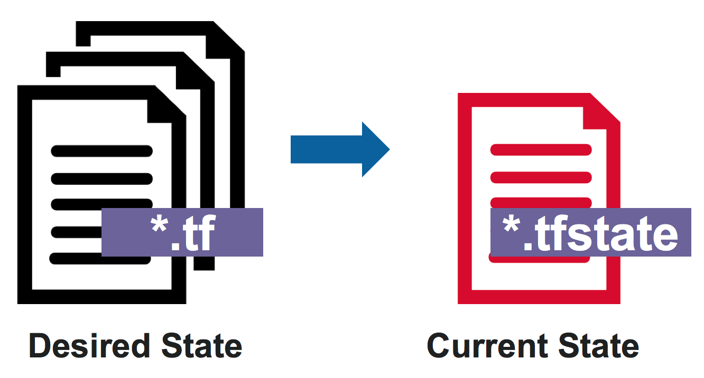
Terraform state file
Most important file in Terraform!
Current state of the environment
“Backends”
Notes:
The state file is the most important file in Terraform
It describes the current state of your environment, and we should make sure to never lose it
Terraform uses this file to keep track of what it has created and what hasn’t
We’re not going over managing secrets/passwords used in terraform configurations in this workshop but it’s very important to know for future configurations that the terraform state file stores all secrets/passwords in plain text and there is no way you can change this. The state file is stored on the local machine where you’re working on your terraform project. Later in this workshop, we’re going to go through backends which is ways we can install the file securely and remotely by defining a backend to our configuration.

Slide 13
Recap terraform commands demo
Terraform init, plan, apply and destroy
Terraform state file
Notes:
We got to deploy our configuration during this demo. We used the four most common commands but there are a lot more of course. We’re not going to go through those commands in this workshop because it would become too advanced and we’re trying to keep things simple here.
We also looked at the tfstate file which is the most important file in terraform and this file describes the current state of your environment (repetition is key to mastery so I can not help but keep repeating that the state file is important).

Slide 14
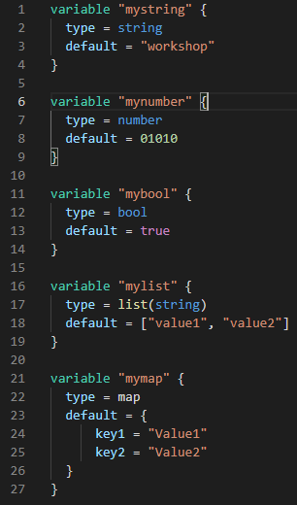
Variables & outputs
Constraints
string
number
bool
Constructors
list(<TYPE>)
map (<TYPE>)
Input variables
tfvars files
Notes:
Variables are way for setting a a value that you can use multiple times
They serve as parameters for a Terraform configuration, so users can customize behavior without editing the source
Terraform knows the following type of constraints you can use for your variable types and constructors you can use to specify complex types such as collections. There are also other constructors that are not mentioned here but can be used in Terraform
We’re also going to look into different ways how to set the values for terraform variables like input variables and tfvars files
Last but not least I’m going to show you how you can make use of outputs, to retrieve information on a resource that you want to know the compute generated attribute of. Remember the “known after apply” attributes

Slide 15
DEMO Variables & outputs
Notes:
Variables & Outputs demo
Section 1
Create a folder called “variables&outputs”
Create a “main.tf” file
Copy provider block from the earlier configuraton into your main.tf
Copy resources from earlier configuraton into your main.tf
Add the following variable blocks with the type of string to your variables.tf:
location – rgname – vnetname
Add variable with the type of bool to your variables.tf:
Vmprotection
Add default = false
Add variable with the type of list(string) to your variables.tf:
Vnetaddress [“10.0.0.0/16”, “10.1.0.0/16”]
Add variable with the type of map to your variables.tf:
Subnetmap
Add default = {
subnet01_name = "subnet01“
subnet01_prefix = "10.0.0.0/24"
subnet02_name = "subnet02"
subnet02_prefix = "10.1.0.0/24"
}
Change the resources in your main.tf to use the variables (see the source code on GitHub as an example)
Add the ouput block for vnetid like in the source code on GitHub
An output block outputs information in your terminal about a specific attribute of a resource that is only known after the resource is created
Open this folder in integrated terminal
Run terraform init
Run terraform apply --auto-approve and you should see the attributes like vnet name and address spaces etc. Also an output of the vnetid is shown which is only known after apply
Before continuing run terraform destroy --auto-approve
------------------------------
Section 2
Remove the default input of the vnetname variable leaving only the description and the type.
Run terraform plan again and it will ask for input during the run. You have created an input variable and you can see the description of that variable in the terminal.
------------------------------
Section 3
Create a .tfvars file and add the value of the vnet name in there called “tf-workshop-vnet01”
Run terraform plan again and you’ll see that terraform picks up the value from the tfvars file automatically because it recognizes these files and combines them with your variables declared in your variables.tf

Slide 16
Recap variables & outputs demo
Created variables
Constraints and constructors
Input variables
tfvars file
outputs
Notes:
We’ve created variables of the type string, bool, list of string and a map. We also defined default inputs for those variables and used them to create resources.
Other ways we looked at, is the use of input variables and a tfvars file where terraform automatically picks up the values for set variables mentioned in the tfvars file
Outputs are a way to show you an attribute reference after a resource has been created. This comes in handy when you need to know an attribute that is only generated after the creation of a resource, remember the “known after apply” attributes

Slide 17

Dependencies
Implicit dependencies
Explicit dependencies
Notes:
Implicit dependencies are the primary way that Terraform understands the relationships between your resources
You write your configuration in a declarative way and Terraform knows for the most part which resources have dependencies and what needs to be created first
Sometimes there are dependencies between resources that are not visible to Terraform, however, a depends on argument is accepted by any resource block and accepts a list of resources to create Explicit dependencies for
To illustrate this, we will do this in a demo later but first we’re going over to the following slide and talk about data sources

Slide 18
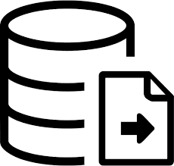
Data Sources
Information outside Terraform
Data block
API request to retrieve information
Notes:
Data sources are a way to retrieve information outside of a Terraform configuration
A data source is accessed via a special kind of resource known as a data resource, using a data block
What data sources do is make an API request to the provider to get information, they don’t set anything up like a resource does
You can query existing resources from the Azure provider or query a resource defined by another separate terraform configuration

Slide 19
DEMO Dependencies & data sources
Notes:
Dependencies & data sources demo
Section 1
Create a new folder “dependencies&datasources”
Create a new main.tf and copy the provider and resource group of an earlier configuration
Add an App Service Plan and App service to your main.tf
Add the depends_on argument to the app service referring to the plan (remember to refer to the source code on GitHub if needed)
Terraform knows that an app plan belongs to an app service but for the purpose of learning, we’re adding this explicit dependency
Run terraform apply and approve the changes
Without the explicit dependancy, terraform creates multiple resources in parallel. But, with the explicit dependency defined in this configuration, Terraform creates the resources one by one. This means that it waits till the first resource is created, before the other one comes in that has an explicit
dependency defined.
------------------------------
Section 2
Create a new resource group and storage account manually in the azure portal
Remember that a storage account name must be globally unique
Create a container in the storage account called “containerformyapp”
Go back to your main tf and add a data source for the storage account you just created manually
When referring to my source code on GitHub, keep in mind here to set the name of your own storage account you just created
Configure an output with the storage account tier
Uncomment the storage account sub block in the azure app service configuration (you’ll see the reference in this block to the data source)
Run terraform apply and approve the changes
Open the app service in Azure
Go to the “configuration” tab
Open “path mappings”
You’ll see the storage account container that was created manually. It's now configured in the app service, that was created by Terraform with the use of a data source block, to retrieve the information on a resource that was outside your Terraform configuration.
------------------------------
Note!:
Run terraform destroy to delete the resources from your Azure subscription. Leave the storage account that you created manually for the next section of this PowerPoint presentation.

Slide 20
Recap dependencies & data sources demo
Created an explicit dependency
Made use of a data source
Notes:
You created an explicit dependency for an azure app service to depend on an app service plan, by providing the ‘depends_on’ argument in our configuration. This way Terraform won’t create these resources in parallel, but it will create the app service plan first. After the creation of the app service plan is finished, the app service is created.
You created a storage account manually in the portal (outside our Terraform configuration) and used a data source to retrieve all the information needed on that storage account, to be able to mount it to the azure app service.

Slide 21
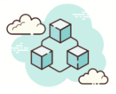
Terraform modules
Container for multiple resources
Repeatable use
Module block
Notes:
A module is a container for multiple resources that are used together
Modules are used to create configurations that have a repeatable use, that you don’t want to configure or copy/paste repeatedly when creating new configurations
Modules can also be called multiple times, either within the same configuration or in separate configurations, allowing resource configurations to be packaged and re-used
Until now we have seen a resource block and a data source block in our configurations. In the demo that follows, we’re going to create a module and use a module block in our configuration.

Slide 22
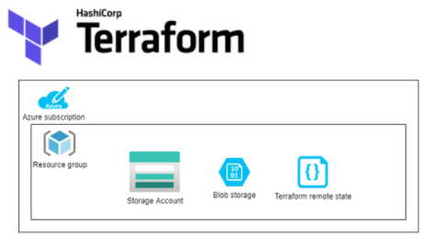
Terraform remote backend
Terraform state location
Remote backend instead of local storage
Notes:
Backends define where Terraforms state file snapshots are stored.
By default, Terraform implicitly uses a backend called local to store the state as a local file on disk (your local machine)
Every other backend stores the state file in a remote service of some kind, which allows multiple people to access it
Accessing the state file in a remote service generally requires access credentials

Slide 23
DEMO Modules & remote backends
Notes:
Modules & remote backends demo
Section 1
Create a new folder “modules&remotebackends”
Create a main.tf file and copy the provider and resource group from the previous configuration
Create a folder “myapp” within the folder “modules&remotebackends”
Create a main.tf for myapp folder
Copy and paste the configuration from the source code on GitHub (app plan, app service and 2 variables)
Declare the module block in the root main.tf file
Configure the source of the module
Configure the two variables that you have set
------------------------------
Section 2
In the root main.tf add to the terraform block:
backend “azurerm” {
resource_group_name = "tfstate-rg“ # name of the resource group in Azure you created manually
storage_account_name = "tfstatebesart“ # name of the storage account in Azure you created manually
container_name = "tfstate“ # create a container if you don’t have one or use “mycontainerapp” you created earlier
key = "workshop.tfstate“ # the name of the terraform.tfstate file (can be any name as long as it ends in .tfstate)
}
Run terraform init to initialize the backend and you’ll receive the message:
Successfully configured the backend "azurerm"! Terraform will automatically use this backend unless the backend configuration changes.
Run terraform apply and approve the changes
Check the storage container in your Azure subscription and you should see the “workshop.tfstate” file there instead of it being locally on your machine. Everyone who gets access or has access to this storage account and when working with version control (Git) on the same source code, can access this state file. In this way you can work together with others on the same project.
It’s also a best practice to store the state file in a remote backend! For AWS you could use for example an S3 bucket.

Slide 24
Recap modules & remote backends demo
Created a module
Saved the state file in a remote backend
Notes:
You created a terraform module of an azure app service and an app service plan that you can call upon when you want to create those resources. You have a reusable Terraform module
The state file has been stored in a secure place in your Azure subscription (remote backend)
The state file can be accessed by multiple people if they have access to the storage and we can produce all kinds of security measures in place for the storage account like a resource lock or geo-redundancy or backup options which keeps the state file even more secure
It’s a best practice when working in a team to store the state file in a remote backend
For Azure you used a storage account, but you can also store the state file in other remote backends. Take AWS for example. You could use an S3 bucket as the backend for the state file.

Slide 25
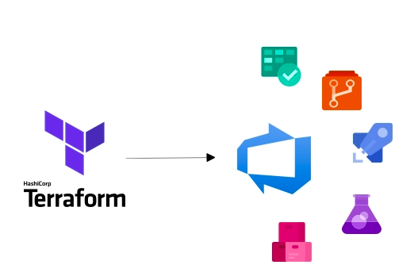
Terraform & Azure DevOps
Automating infrastructure with code & CI/CD pipelines
Notes:
You had a real crash course on Terraform going through these slides and demo’s
You have learned the needed basics and somewhat more advanced topics on Terraform
There is A LOT MORE to learn on Terraform that we won’t go through in this training but it’s worth diving deeper the more you get comfortable with Terraform
Continue with the last demo and set up a CI/CD multi-stage pipeline in Azure DevOps to automatically deploy a Terraform configuration

Slide 26
DEMO Azure DevOps
Notes:
Automation with Azure DevOps demo
Section 1
Set up an Azure DevOps organization for free to get started https://azure.microsoft.com/en-us/services/devops/?nav=min on this page
Give your organization a name
Choose the location that is most close to you where your project will be hosted (Azure Region)
Create a new project and give that a name as well (leave everything else default)
In your project, go to project settings
Set up a service connection https://docs.microsoft.com/en-us/azure/devops/pipelines/library/connect-to-azure?view=azure-devops
Choose Azure Resource Manager for your Service Connection and click next
Choose Service principal (automatic)
Select your subscription
Give the service connection a name (later used for your pipeline)
Tik the box “grant access permission to all pipelines”
------------------------------
Section 2
Copy the “cicdautomation” folder from the source code in my GitHub repo and add it to your root folder (in my case “Terraform-Workshop”)
This folder contains almost the same configuration as the “modules&remotebackends” config but it’s slightly different and we’re going to use this configuration to deploy from an Azure DevOps pipeline
Copy the “.gitignore” file from the source code
.gitignore file contains file types and folders that you don’t want to push to your central repository like the terraform providers or files containing secrets etc.
Copy the “azuredevops-pipeline.yml” from the source code
This is the yaml file that will be used to set up our “CI/CD” pipeline in Azure DevOps in a later section
In VS Code open the root folder in an integrated terminal (for more info on Git check out https://docs.microsoft.com/en-us/learn/modules/intro-to-git/)
Execute the command: git init
Execute the command: git add .
Execute the command: git commit –m “initial commit”
Go to Repos in your Azure DevOps project
Below the “Push an existing repository from command line” copy the command: git remote add origin <url of your azure devops repo>
Execute the command in your VS Code terminal: git remote add origin <url of your azure devops repo>
Execute the command in your VS Code terminal: git push -u origin –all
If you look over in your Azure DevOps project in the Repos section, you’ll see that your code has been pushed over to Azure DevOps
------------------------------
Section 3
Go to the Azure DevOps marketplace https://marketplace.visualstudio.com/azuredevops
Search for Terraform
Select Terraform from Microsoft DevLabs and click “get it free”
Install the extension for your Azure DevOps organization
------------------------------
Section 4
Open your Azure DevOps project
Go to the Pipelines section and open “Library”
Create a new variable group
Name: backend_config
Variables key value pairs (you can use the resource group and storage account that was manually created earlier):
tbc__backend_service_arm <service connection name>
tbc__resource_group_name <resource group name>
tbc__storage_account_name <storage account name>
tbc__stcontainer_name <storage container name>
tbc__tfstate <tfstate file name>
------------------------------
Section 5
Open the Pipelines page
Click on “New Pipeline”
Select “Azure Repos Git”
Select the repository name that contains your code
Select “Existing Azure Pipelines YAML File”
Select in the “Path” drop down bar the “azuredevops-pipeline.yml” file and click continue
Click “Run” in the next page and watch how the Terraform configuration in the folder “cicdautomation” will be deployed into your Azure subscription automatically
The yaml file contains comments in each section with an explanation what they stand for so be sure to check that out.

